Slide 1
Syntax Analysis Or Parsing

Slide 2
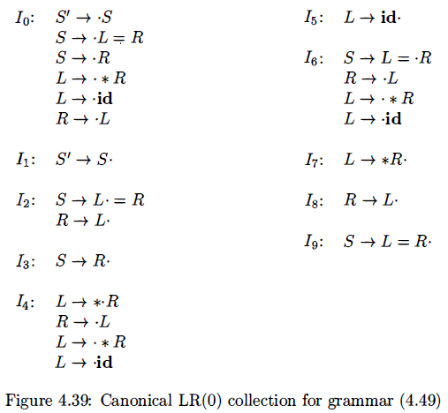

Conflicts in SLR parsing

Slide 3
Conflict in SLR parsing
The follow set contains symbols that can follow R in any position within a valid sentential form
but it does not precisely indicate which symbols follow R at this particular point in a derivation
Even though = is in Follow(R) because of the other contexts that an R can appear, in this particular situation, it is not appropriate because when deriving S –> R –> L, = cannot follow R.

Slide 4
LR(1) parsing
The LR(1) parsing method, which makes full use of the lookahead symbol(s)
This method uses a large set of items, called the LR(1) items
canonical LR(1) computes a more precise notion of the appropriate lookahead within a particular context
thus is able to resolve conflicts that SLR would encounter

Slide 5
LR(1) Item
To avoid some of invalid reductions, the states need to carry more information
Extra information is put into a state by including a terminal symbol as a second component in an item
A LR(1) item is:
A → α.β,a where a is the look-head of the LR(1) item
(a is a terminal or end-marker.)

Slide 6
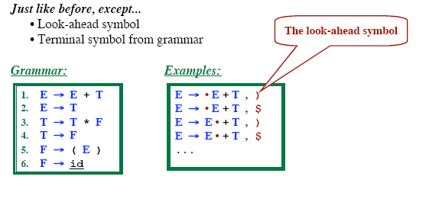
LR (1) Items

Slide 7
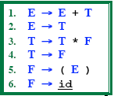
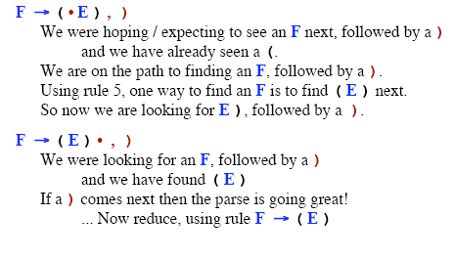
Intuition behind LR (1) Items

Slide 8
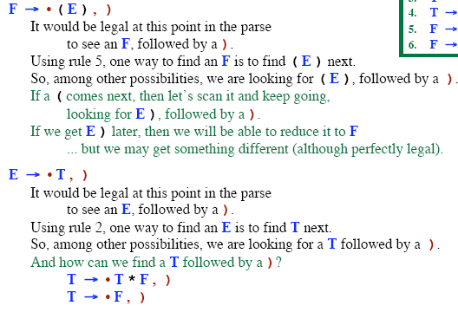
Intuition behind LR (1) Items

Slide 9
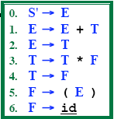
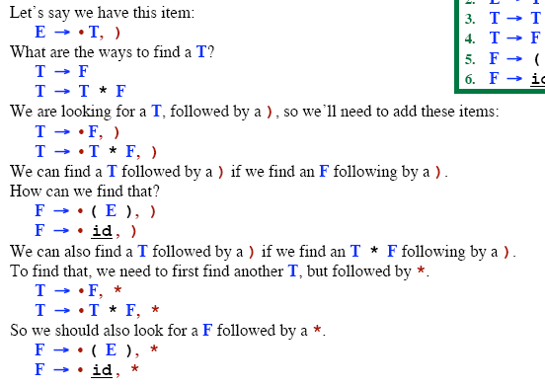
The CLOSURE Function

Slide 10
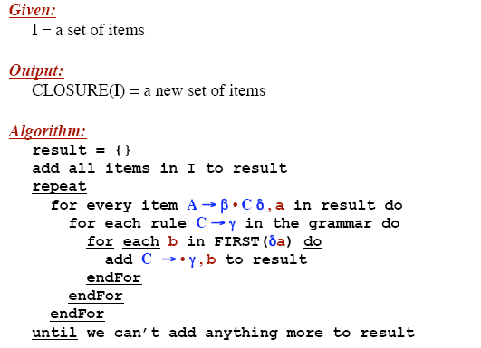
The CLOSURE Function

Slide 11
LR (1) Parsing Example
Consider the grammar:
S -> CC
C -> cC
C -> d

Slide 12
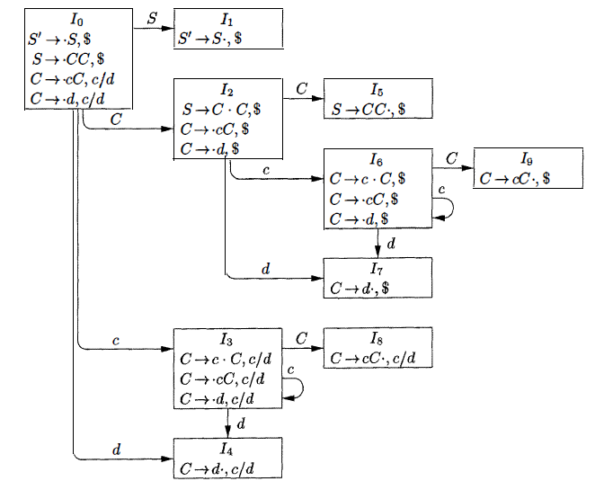
LR (1) Parsing Example
S’ -> S
S -> CC
C -> cC
C -> d

Slide 13
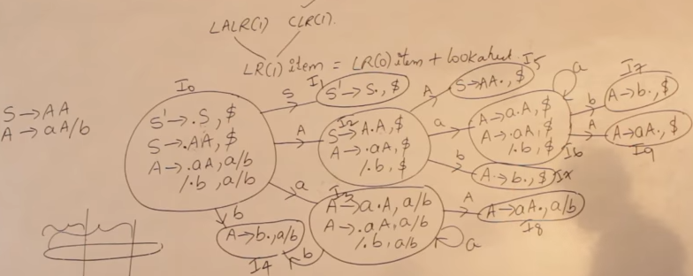
LR (1) Parsing Example
https://www.youtube.com/watch?v=VSkfnRfNuwI

Slide 14
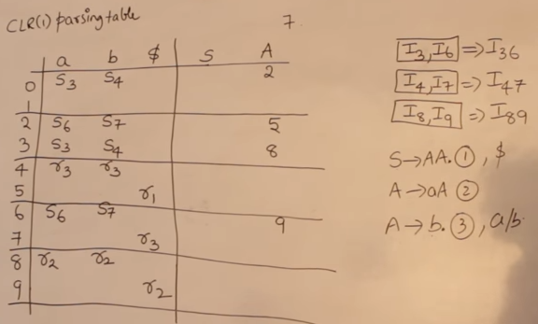
LR (1) Parsing Example

Slide 15
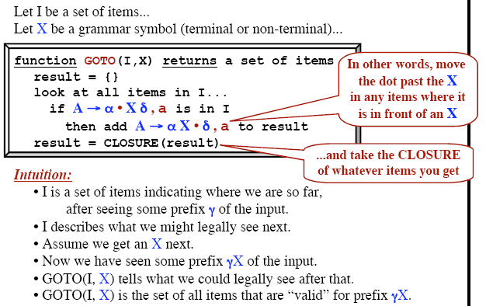
The GOTO Function

Slide 16
Construction of LR(1) Parsing Tables
Construct the canonical collection of sets of LR(1) items for G’. C←{I₀,...,I_{n}}
Create the parsing action table as follows
If a is a terminal, A→α.aβ,b in I_{i} and goto(I_{i},a)=I_{j} then action[i,a] is shift j.
If A→α.,a is in I_{i} , then action[i,a] is reduce A→α where A≠S’.
If S’→S.,$ is in I_{i} , then action[i,$] is accept.
If any conflicting actions generated by these rules, the grammar is not LR(1).
Create the parsing goto table
for all non-terminals A, if goto(I_{i},A)=I_{j} then goto[i,A]=j
All entries not defined by (2) and (3) are errors.
Initial state of the parser contains S’→.S,$

Slide 17
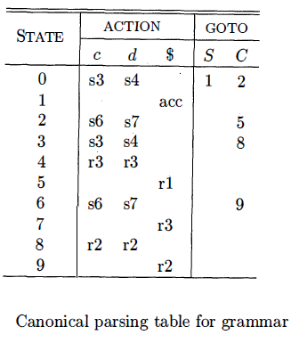
LR (1) Parsing Example
S’ -> S
S -> CC
C -> cC
C -> d

Slide 18
LALR Parsing Tables
LALR stands for LookAhead LR.
LALR parsers are often used in practice because LALR parsing tables are smaller than LR(1) parsing tables
The number of states in SLR and LALR parsing tables for a grammar G will be equal
But LALR parsers recognize more grammars than SLR parsers
A state of LALR parser will be again a set of LR(1) items

Slide 19
The Core of A Set of LR(1) Items
The core of a set of LR(1) items is the set of its first
component
. S → L.=R
R → L.,$
R → L.
Ex: S → L
=R,$
Core
Find the states (sets of LR(1) items) in a canonical LR(1) parser with same cores
Merge them as a single state
I₁:L → id.,= A new state: I₁₂: L → id.,= I₂:L → id.,$
L → id.,$
Same Core
Merge Them
We will do this for all states of a canonical LR(1) parser to get the states of the LALR parser

Slide 20
Creation of LALR Parsing Tables
Create the canonical LR(1) collection of the sets of LR(1) items for the given grammar
Find each core; find all sets having that same core; replace those sets having same cores with a single set which is their union
Create the parsing tables (action and goto tables) same as the construction of the parsing tables of LR(1) parser
If J=I₁ ∪ ... ∪ I_{k} since I₁,...,I_{k} have same cores,
cores of goto(I₁,X),...,goto(I₂,X) must be same.
– So, goto(J,X)=K, where K is the union of all sets of items having same cores as goto(I₁,X).
If no conflict is introduced, the grammar is LALR(1) grammar. (We may only introduce reduce/reduce conflicts; we cannot
– Note that:
Introduce a shift/reduce conflict)

Slide 21
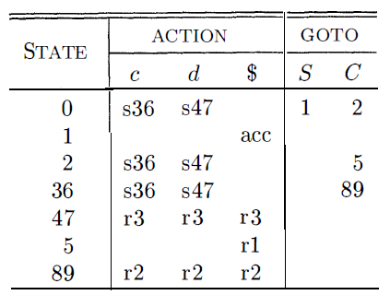
Creation of LALR Parsing Tables
S’ -> S
S -> CC
C -> cC
C -> d
https://www.youtube.com/watch?v=VSkfnRfNuwI&t=1436s

Slide 22
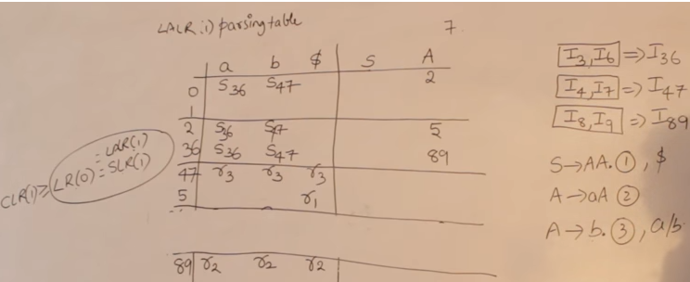
Creation of LALR Parsing Tables

Slide 23
Creating LALR Parsing Tables
This merging process may introduce a reduce/reduce conflict in the resulting LALR parser (so the grammar is NOT LALR)
But this process does not produce a shift/reduce conflict

Slide 24
Shift/Reduce Conflict
We say that we cannot introduce a shift/reduce conflict during the merging process for the creation of the states of a LALR parser
Assume that we can introduce a shift/reduce conflict, In this
case, a state of LALR parser must have:
A → α.,a and B → β.aγ,b
This means that a state of the canonical LR(1) parser must have:
A → α.,a and B → β.aγ,c
But, this state has also a shift/reduce conflict. i.e. The original canonical LR(1) parser has a conflict
(Reason for this, the shift operation does not depend on lookaheads)

Slide 25
Reduce/Reduce Conflict
But, we may introduce a reduce/reduce conflict during the shrink process for the creation of the states of a LALR parser
I₁ : A → α.,a B → α.,b
I₂: A → α.,b B → α.,c
reduce/reduce conflict
⇓
I₁₂: A → α.,a/b B → α.,b/c

Slide 26
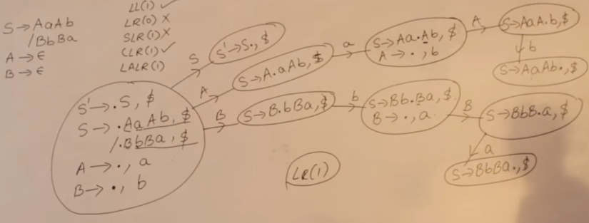
Conflicts and acceptance of
Grammar for parsing
https://www.youtube.com/watch?v=Nxj0g1mk5Ak

Slide 27

https://www.youtube.com/watch?v=Nxj0g1mk5Ak

Slide 28
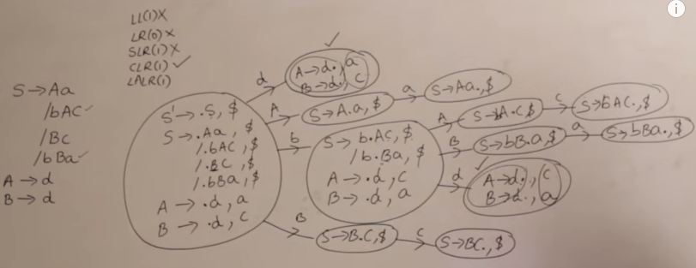
Conflicts and acceptance of
Grammar for parsing
https://www.youtube.com/watch?v=Nxj0g1mk5Ak

Slide 29
Any Questions ?

